Slide 1
Employee Data Analysis using Excel
STUDENT NAME: S.SHRUTHI
REGISTER NO: 312212128
DEPARTMENT: COMMERCE[B.COM(GENERAL)]
COLLEGE: MAR GREGORIOS COLLEGE OF ARTS AND SCIENCE

Slide 2
PROJECT TITLE
Analysing employee termination
with excel

Slide 3


AGENDA
Problem Statement
Project Overview
End Users
Our Solution and Proposition
Dataset Description
Modelling Approach
Results and Discussion
Conclusion
3/21/2024 Annual Review

Slide 4

PROBLEM STATEMENT
"To improve employee retention and optimize workforce management, we need to analyze the patterns and causes of employee terminations within our organization. Using Excel, we will conduct a detailed analysis of termination data to identify key trends, factors, and correlations. The goal is to understand the underlying reasons behind employee departures, categorize these reasons, and uncover any significant patterns or anomalies. This analysis will help in developing strategies to reduce turnover rates and enhance overall employee satisfaction."

Slide 5

PROJECT OVERVIEW
Analyzing employee termination using excel involves several Step to collect ,organize ,and evaluate data effectively. Here a step -by-step guide to help you with this process
1.Project title
2.Project objective
3.Scope
4.Key activities
5.deliverables

Slide 6

WHO ARE THE END USERS?
The end users in analyzing employee termination data using Excel can vary depending on the organization and the specific goals of the analysis. Here are some common end users who might benefit from or use the results of this analysis:
1.HR MANAGERS
2.HR ANALYSTS
3.SENIOR MANAGEMENT
4.DEPARTMENT HEADS
5.TALENT ACQUISITION SPECIALISTS

Slide 7

OUR SOLUTION AND ITS VALUE PROPOSITION
Filtering – for removing unwanted value
Pivot table – summarizing the data into smaller data
Graph – data visualize in to picture for understanding purpose

Slide 8
Dataset Description
employee= Edunet dash board
26 features Name-text
Count of termination type
Employee classification type

Slide 9

THE "WOW" IN OUR SOLUTION
Pivot table and filtering is wow in my solution.
3/21/2024 Annual Review
9

Slide 10
MODELLING
To Analysing Employee termination with pie Chart in excel follow these steps after setting up your data and creating a employee performance :
1. collection of data :
collection of data using edunet dash board
2. select data:
select and highlight data like , name , classification type , count of termination
3. filtering with pivot table:
filtering with selected data using pivot table for required employee information
4. convert into pivot chart :
after filtering the datas with pivot table, you have to convert into pivot chart like pie chart
10

Slide 11
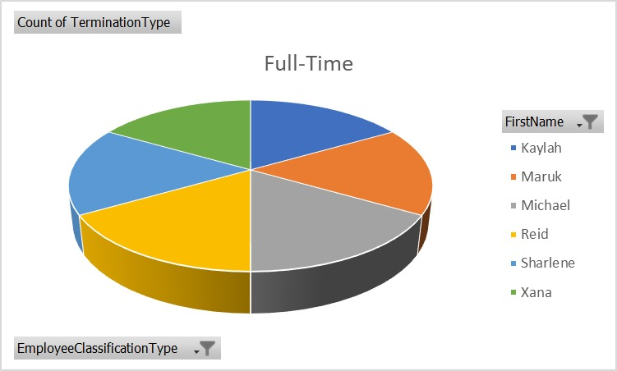
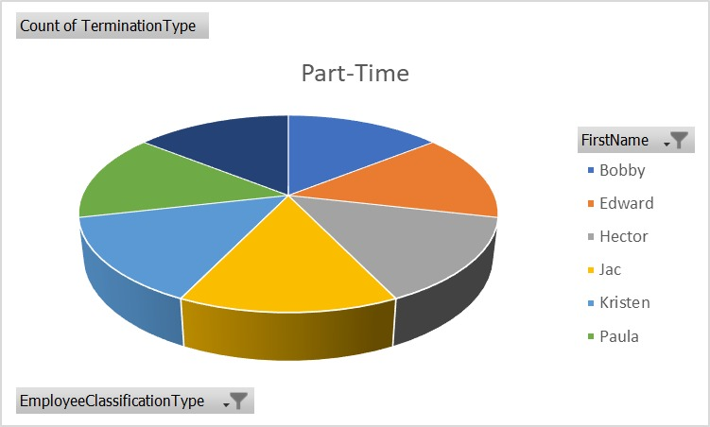

RESULTS
11

Slide 12
conclusion
In conclusion, the analysis of employee terminations conducted using Excel has provided valuable insights into the patterns and causes of turnover within the organization. The data reveals notable trends, such as higher termination rates in specific departments and roles, as well as common reasons for departures, including performance issues and voluntary resignations. These findings underscore the need for targeted interventions, such as revising HR policies and enhancing employee support programs, to address the underlying causes of turnover. Additionally, the demographic analysis highlights the importance of tailored retention strategies to address specific groups that may be at higher risk of leaving. While the analysis offers a robust overview, it is important to acknowledge its limitations, including potential data gaps and biases. Moving forward, the organization should consider implementing the recommended changes and exploring further analyses to refine its approach to employee retention and satisfaction

